Slide 1
Intro to Python
Overview
Place Python in the world and highlight some cool use cases. Then a quick overview of the most important topics. Finally a chance to do a little data project + package demo. Recap and provide resources to continue the Python journey
Important Note
Timing will be much easier if anaconda installed before lesson starts
Learning Objectives
In this lesson, students will:
See Python at work in the real world
Understand core aspects of programming in python:
Variables (names and types)
Control Flow (if and for)
Data Structures (list and dict)
Create a plan with resources to continue learning
Duration
120 minutes

Slide 2
Suggested Agenda
Time | Activity | Purpose
0:00 - 0:02 | Welcome | Introduce the lesson’s objectives and agenda.
0:02 - 0:10 | Activity 1 | Why?
0:10 - 0:25 | Activity 2 | Why?
0:25 - 0:30 | Summary | Wrap up the learning and share next steps.

Slide 3
Materials and Preparation
Make sure you have anaconda installed with jupyter and pandas
Look through the slides and presenter notes… shorten some discussions if you have a large class
Check out the Included jupyter notebook for in class live demo materials

Slide 4
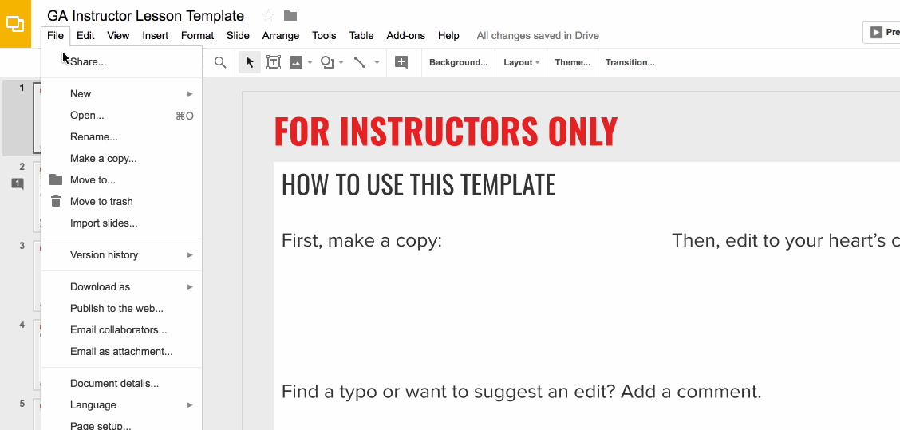
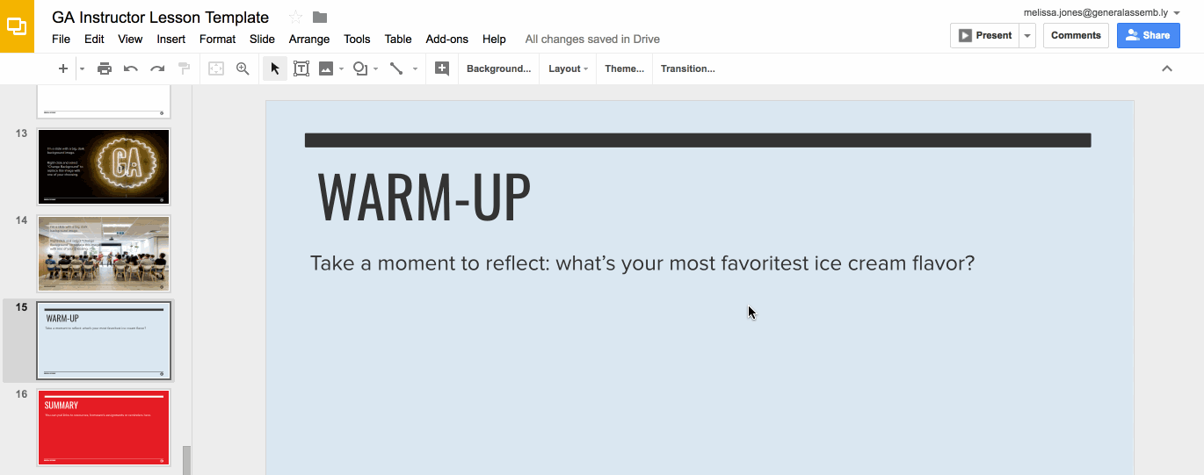
Preparation (Continued)
Ready to customize this lesson?
First things first, make a copy of this presentation. You’ll then be able to edit to your 💗’s content.
Find a typo or want to suggest an edit?
Add a comment. Our Product Advisory Board will review and incorporate your suggestions.

Slide 5
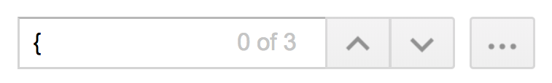
Preparation (Continued)
Remember to press Command F and do a search for instances of brackets in the deck. All instances of brackets denote places where instructors must fill in information/customize prior to presenting in class.

Slide 6
Differentiation and Extensions
This is a very basic lesson. Encourage advanced students to spend time exploring code on their own.
A good next step is to share some sample Python documentation or the PEP 8 style guide.

Slide 7
Intro to Python
WiFi
{WiFi name}
{WiFi password}
{Date}
Please install Python 3.6 from https://anaconda.com/download
Notes:
1 MINUTE
TALKING POINTS
Make sure people are in the right room
If people arrive early, check they have installed Anaconda
TEACHING TIPS
This is a suggestion for the instructor on something to do before, during or after presenting this slide.
This is another suggestion.

Slide 8
{Agenda}
Time | Topic
15 min | Introductions
15 min | Python Overview
15 min | Software Install
40 min | Programming Basics
20 min | Example Program
15 min | Create a Learning Plan
What We’ll Cover Today
In this class, we’ll explore the following topics:
Notes:
1 MINUTES
TALKING POINTS
This is a suggested talking point.
This is another.
TEACHING TIPS
This is a suggestion for the instructor on something to do before, during or after presenting this slide.
This is another suggestion.

Slide 9
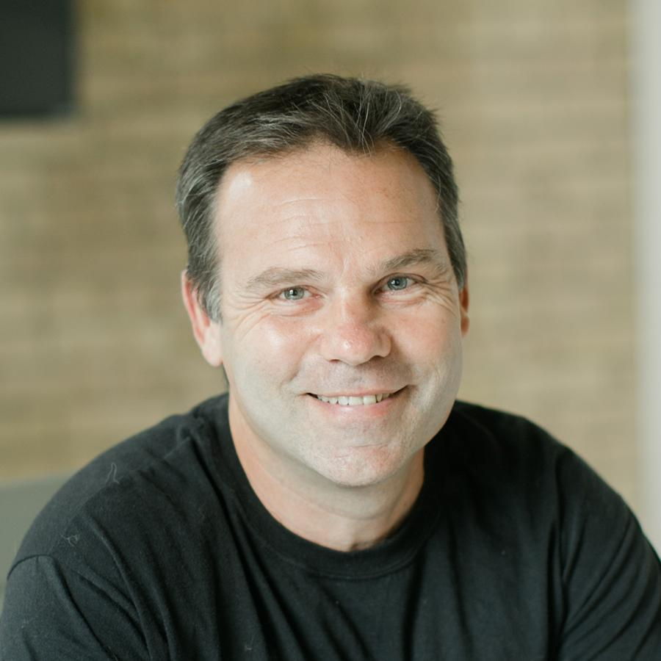
{Your Name and Photo}
{Your Title and Company}
Notes:
2 MINUTES
TALKING POINTS
Introduce yourself and tell students why you are here teaching them
Give brief intro to your:
Education
Teaching experience
Programming Experience
Professional Experience
TEACHING TIPS
The goal of this slide is to answer “Why should I pay attention to you?”

Slide 10
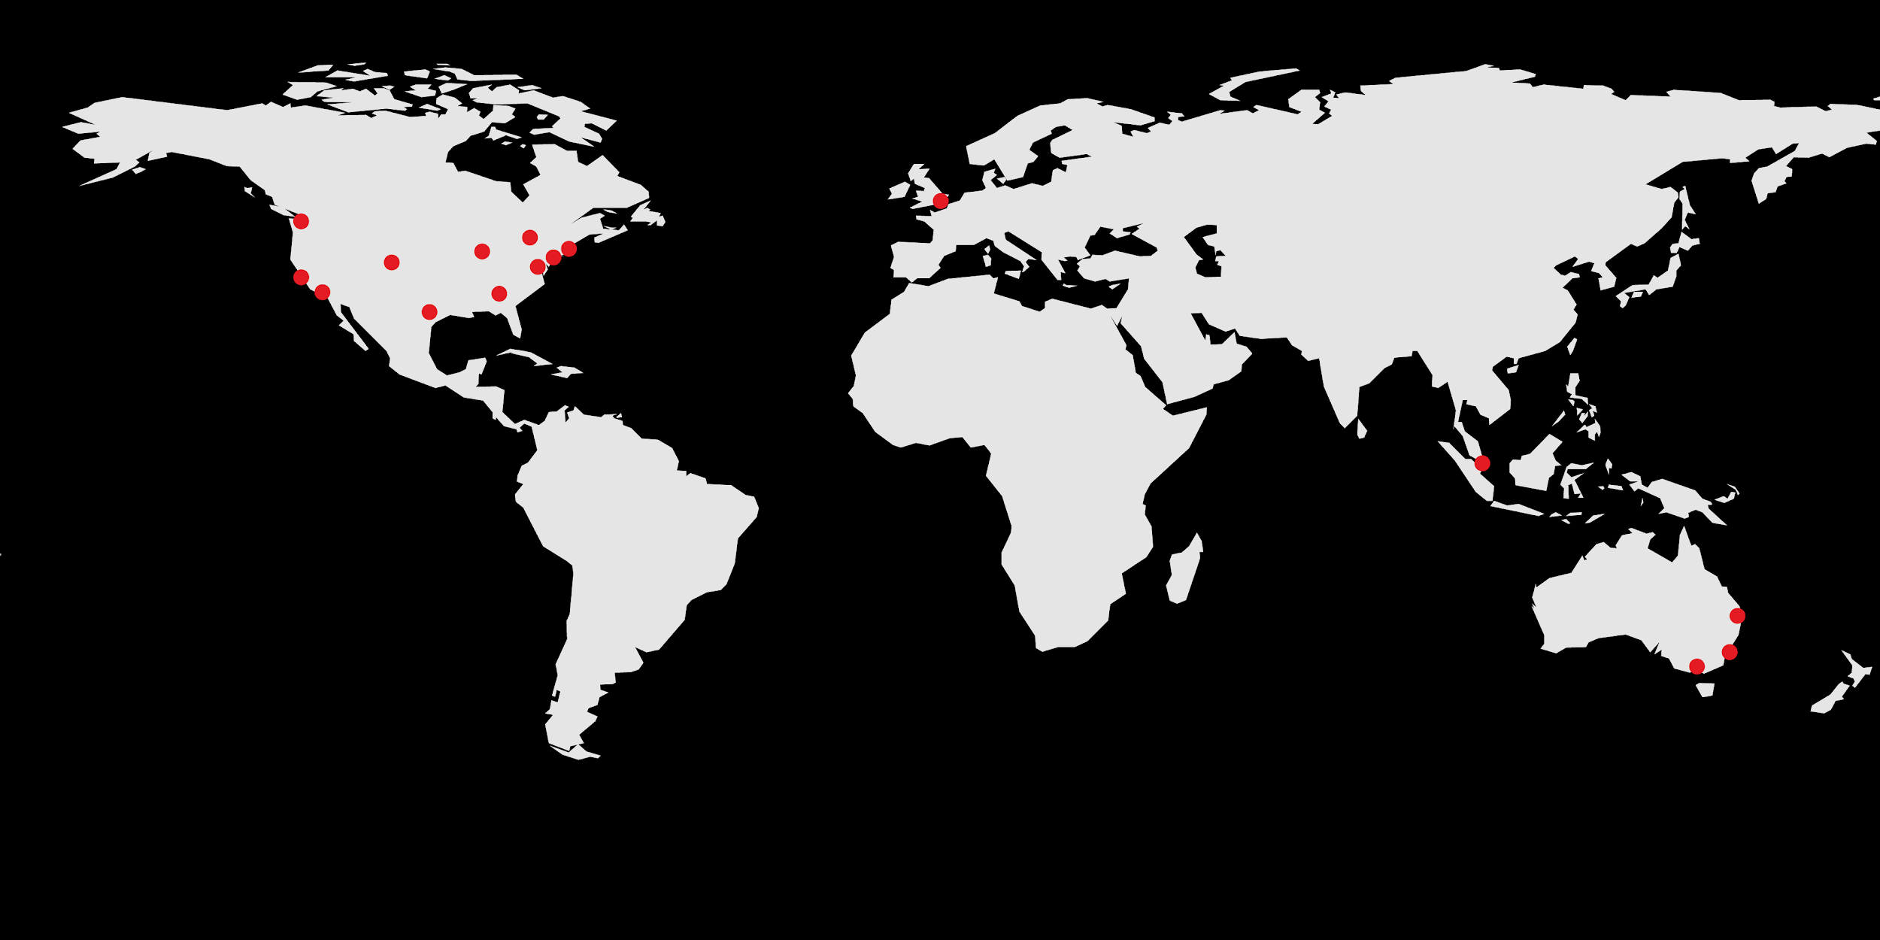
About GA
Notes:
1 MINUTE
TALKING POINTS
Welcome!
Campuses across the Country (and world)
40k graduates, sense of community
TEACHING TIPS
This is a suggestion for the instructor on something to do before, during or after presenting this slide.
This is another suggestion.

Slide 11
ABOUT YOU
Introduce yourself:
Name
What Languages have you coded in?
None!, Excel, SQL, HTML, BASH/DOS, C, Python, etc.
What industries are you interested in?
Finance, Technology, Medicine, Publishing, etc.
How will this course help you with your goals?
Share something you recently read/watched/heard.
Notes:
5ish MINUTES
TALKING POINTS
Start yourself as an example - keep it short and to the point.
Get to know the students, go around with each person introducing themselves
Be clear about who is next
TEACHING TIPS
It is important that everyone feel welcome and included in the GA community
Take attendance during this time
You may need to pare down the intros for a large class to keep the lesson moving
Also take notes on experience / industries
If possible, try to point out examples relating to students’ experiences

Slide 12

About this course
Learning Objectives
Discuss the history of Python & how it’s used in different industries
Describe the benefits of a Python workflow when looking at data
Demonstrate basic Python programming fundamentals to solve a real world problem
Create a custom learning plan to build your data science skills after this workshop!
Notes:
5ish MINUTES
TALKING POINTS
TEACHING TIPS

Slide 13
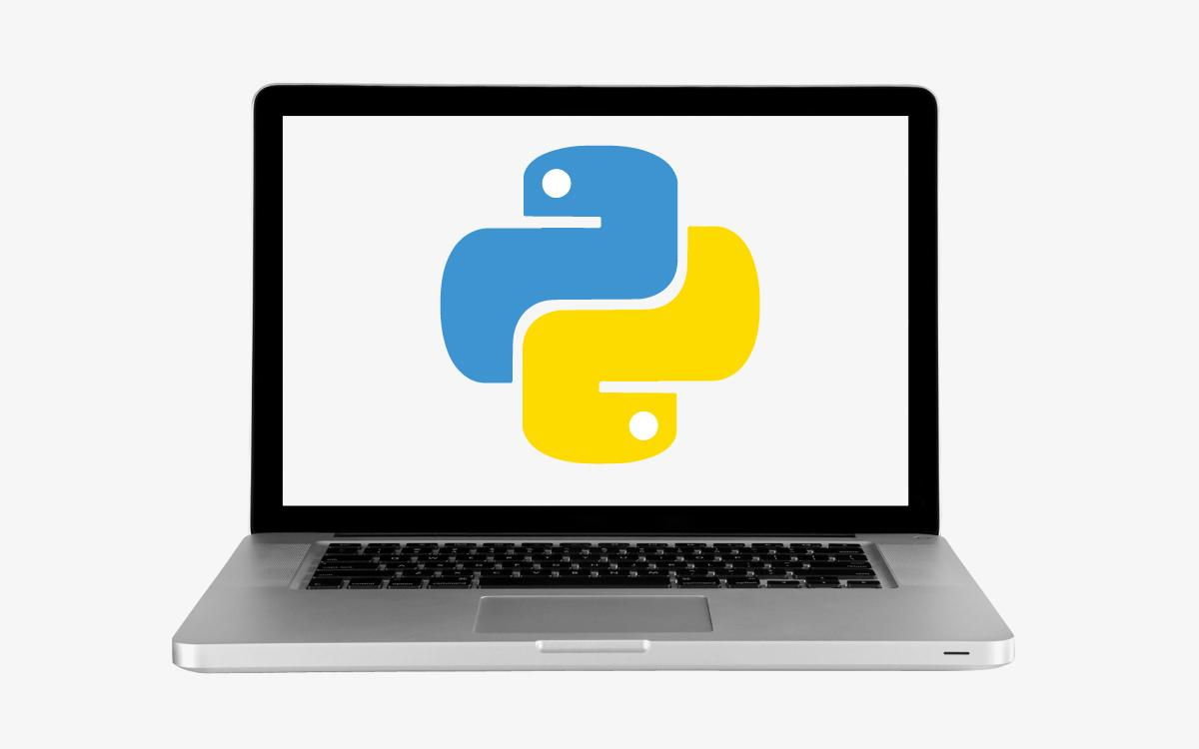
About this course
Getting the most out of this course
Make sure you have the tools you need running smoothly
Think / ask how Python could fit into your workflow
The exercises are guidelines, pursue your interests in during practice
Plan how you will continue your learning
Notes:
5ish MINUTES
TALKING POINTS
TEACHING TIPS

Slide 14
Today dozens of Google engineers use Python, and we're looking for more people with skills in this language.
Peter Norvig, Director of search quality at Google, Inc.
Notes:
15 MINUTES up to this point
Just a time check slide

Slide 15
What Is Python?
Intro to Python

Slide 16
Timing: 15 min
Timing check shoot for 15 minutes into lesson at this point
Notes:
X MINUTES
TALKING POINTS
This is a suggested talking point.
This is another.
TEACHING TIPS
This is a suggestion for the instructor on something to do before, during or after presenting this slide.
This is another suggestion.

Slide 17

What is Python
Created by Guido Van Rossum in 1991
Emphasizes productivity and code readability
Easy to pick up and learn
Easier for many to contribute to production level code
Readable code means that almost anyone can read and understand what code is doing
Notes:
2 MINUTES
TALKING POINTS
Focus on the bolded items
TEACHING TIPS
Goal is to show Python is not a fad, and based on strong fundamentals

Slide 18
Why is Python readable
Interpreted language:
Step by step execution for easier programming ideation
Write once, run anywhere
Performance tradeoff
Object-oriented (OO)
Code with objects that contain data and functions to manipulate it in predefined ways
High-level programming
Use natural language syntax where possible
Notes:
2 MINUTES
TALKING POINTS
Focus on the bolded items
TEACHING TIPS
Goal is to show Python is not a fad, and based on strong fundamentals

Slide 19
Why Python?
Free, Flexible, and Open Source
Rapid prototyping and full-stack commercial applications
Extensible with easy to install libraries
Great documentation
Established and growing community
Scripts can be run many times
When data changes
On different machines
At different times
Notes:
1 MINUTES
TALKING POINTS
Focus on the bolded items
TEACHING TIPS
Goal is to show Python is not a fad, and based on strong fundamentals

Slide 20




Who uses Python?
Industry & Academia
AstroPy
BioPython
Web Development
Youtube
DropBox
Game Development
Civilization IV
Standalone Applications
BitTorrent
Notes:
2 MINUTES
TALKING POINTS
Uses:
Data collection
Data analysis
Web API
Dynamic web interface
Write once run anywhere games and programs
TEACHING TIPS
Goal is to show Python is not a fad, Real companies use it

Slide 21
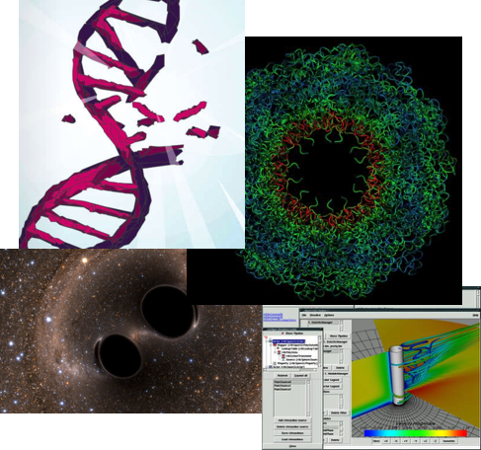
Examples
Industry
Drug discovery
Financial services
Films and special effects
Academia
Gravitational waves
Scientific visualisation
Biomolecule simulation
More
Success Stories
Notes:
2 MINUTES
TALKING POINTS
Review one or two cases of interest
TEACHING TIPS
Goal is to show Python is not a fad, real work is accomplished using it

Slide 22
Storytime
How will you use python?
Job or Industry
Workflow Improvements
Dream Projects
Notes:
5 MINUTES
TALKING POINTS
TEACHING TIPS
This is a suggestion for the instructor on something to do before, during or after presenting this slide.
This is another suggestion.

Slide 23
No great marketing decisions have ever been made on qualitative data.
John Sculley, Former VP PepsiCo + CEO Apple
Notes:
30 MINUTES up to this point

Slide 24
Exploring Python With Anaconda
Intro to Python

Slide 25
Master: Instruction Notes
Timing check: 30 minutes
Notes:
X MINUTES
TALKING POINTS
This is a suggested talking point.
This is another.
TEACHING TIPS
This is a suggestion for the instructor on something to do before, during or after presenting this slide.
This is another suggestion.

Slide 26
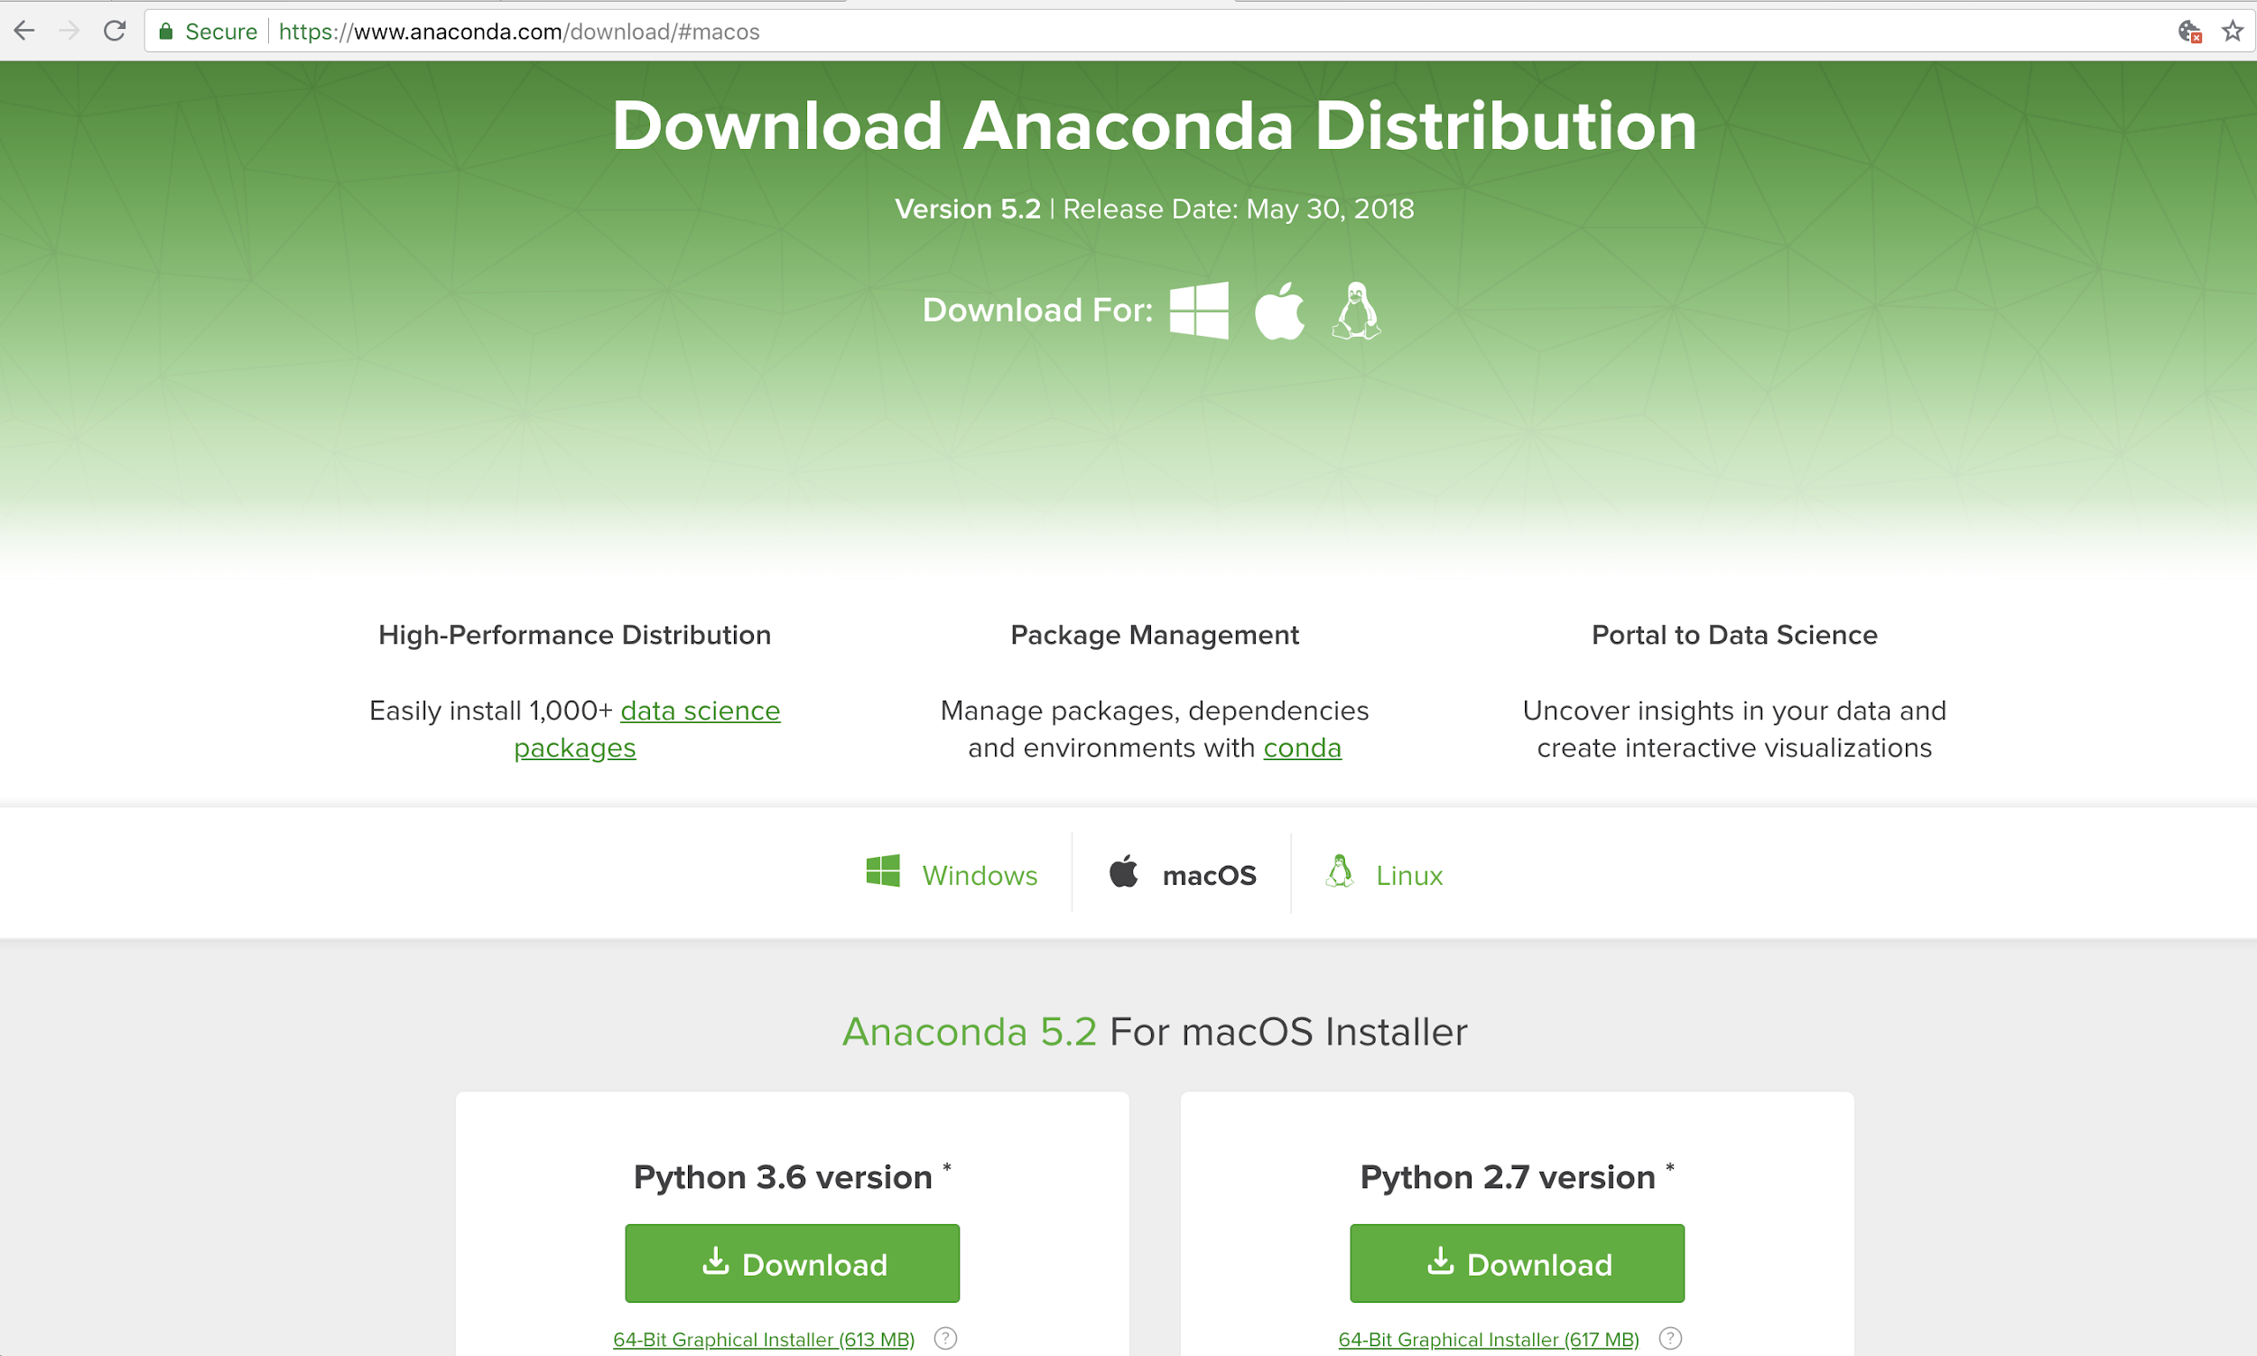
Download Anaconda https://anaconda.com/download
Notes:
1 MINUTES
TALKING POINTS
Give unprepared students a chance to DL and install anaconda
TEACHING TIPS

Slide 27
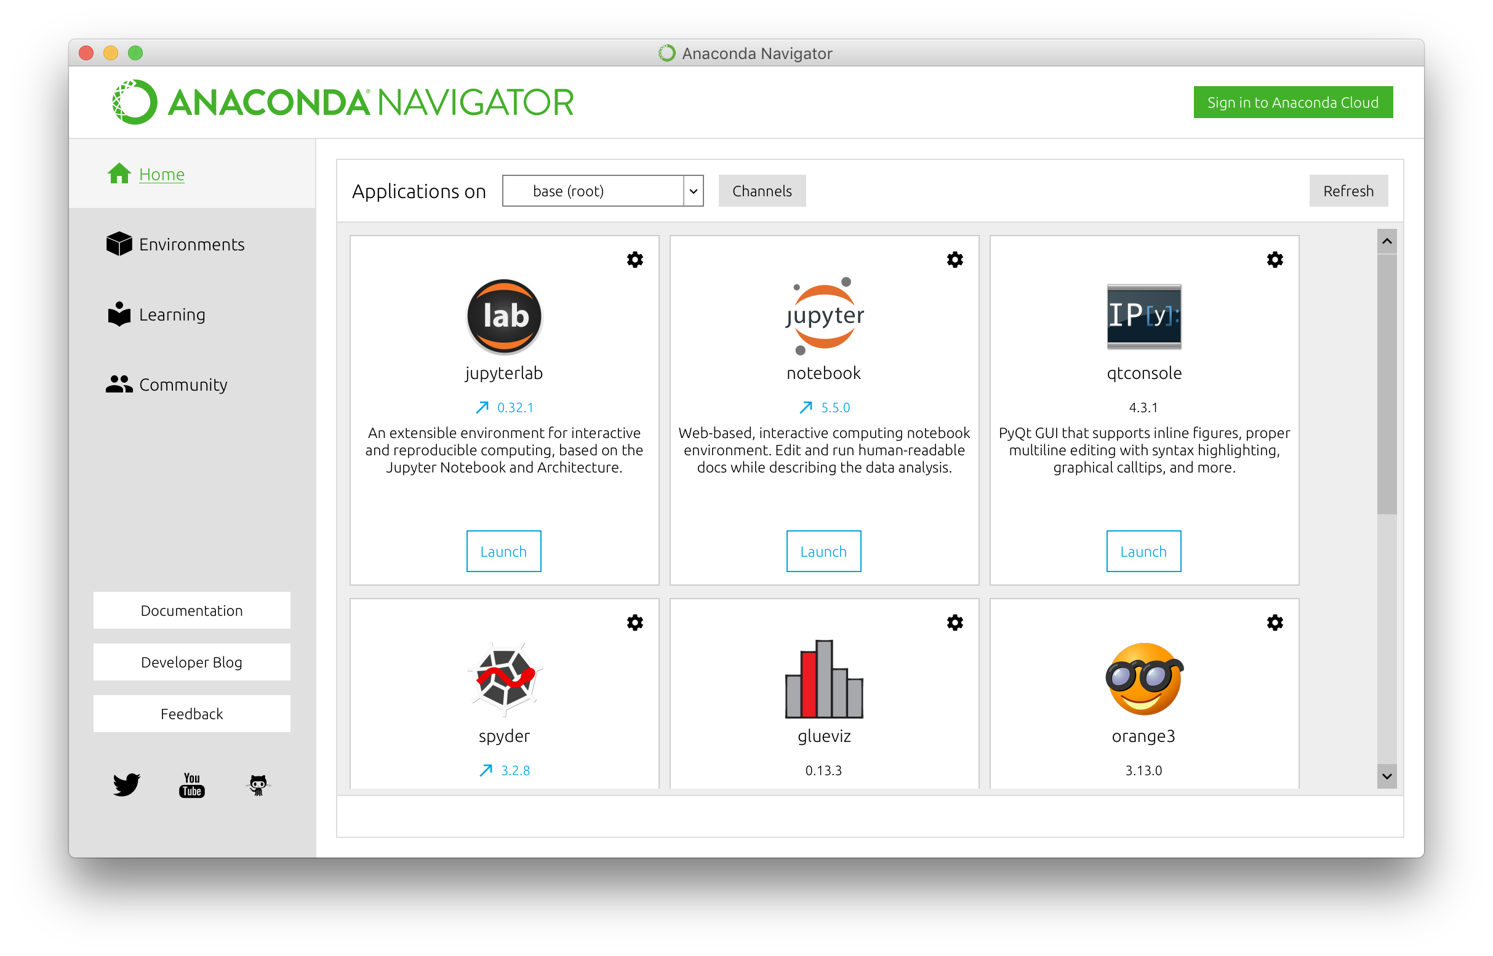
Anaconda Navigator
Notes:
1 MINUTES
TALKING POINTS
Starting jupyter notebook
Search anaconda navigator in spotlight / cortana
TEACHING TIPS

Slide 28
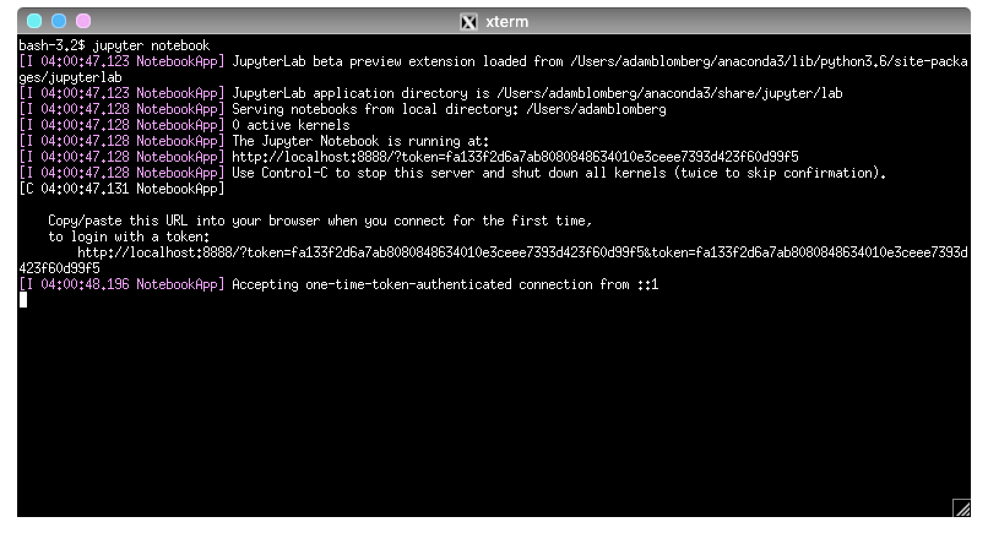
Terminal / Anaconda Prompt
Notes:
1 MINUTES
TALKING POINTS
Alternate method
Search terminal on Mac/Linux or Anaconda Prompt on windows
TEACHING TIPS

Slide 29
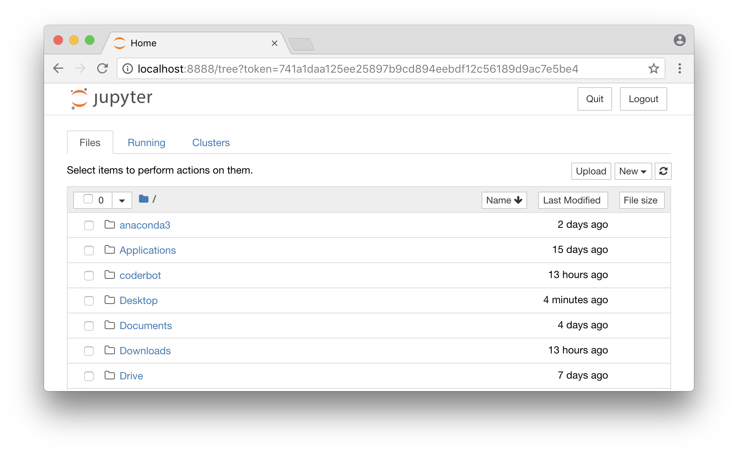
New Web Browser window with personal files
Notes:
1 MINUTES
TALKING POINTS
Should see home folder items… Documents, Downloads, Desktop, etc
TEACHING TIPS

Slide 30
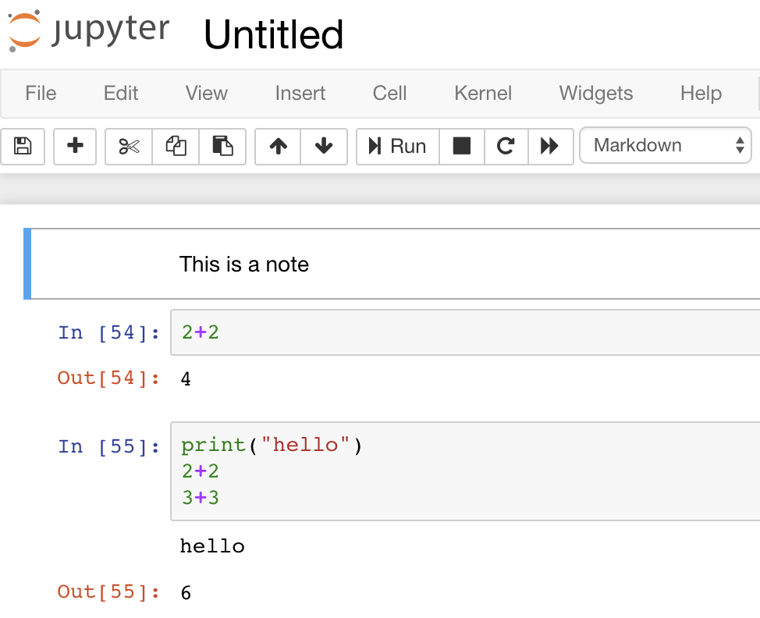
Jupyter Notebook
Cells:
Markdown for notes
Code for Python
Modes
Blue for commands
Green for editing
Execution
Shift + return
Output
Print (all)
Return values (last)
Notes:
5 MINUTES
TALKING POINTS
Run a live demo to go through main points
Rename file
Show blue / green cells and how to switch
Show how to use dropdown menu to change cell between markdown and code
Show shift+enter to run cells
Show how to see output
TEACHING TIPS
Keep it simple!!! Easy to go long here if not careful
Start Jupyter in a different browser from the presentation so command+tab switching between presentation and jupyter is fast + easy

Slide 31
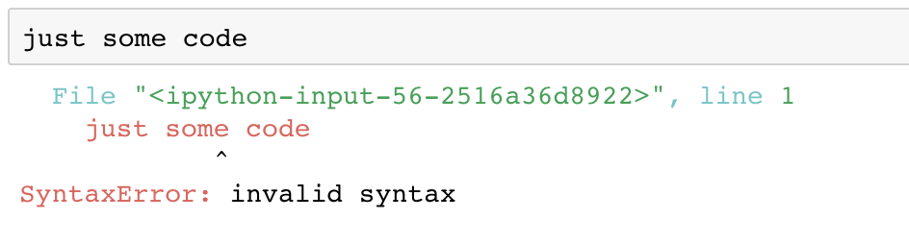
Jupyter Notebook errors
Mistakes happen! Here’s what they look like:
Try to understand what went wrong
Attempt to fix the problem
Execute the cell again
Notes:
1 MINUTES
TALKING POINTS
Focus on the bolded items
TEACHING TIPS

Slide 32
Try out Jupyter notebook
5 minutes
Take some time to try out Jupyter notebook.
Make sure you can:
Convert cells between Markdown and Code
Edit and execute a note cell
Edit and execute a code cell
Try to do some math
Make an error
Notes:
5 MINUTES
TALKING POINTS
Try out a few commands, just try to start getting used to the system
TEACHING TIPS
Goal is to have students execute a few cells in jupyter notebook and understand the results

Slide 33
We wrote more code in python than we were expecting, including all [the] in-game screens and the main interface.
Soren Johnson, Lead designer on Civilization IV, Firaxis Games
Notes:
45 MINUTES up to this point

Slide 34
Python Programming Fundamentals
Intro to Python

Slide 35
Master: Instruction Notes
Timing check: 45 minutes
Notes:
45 MINUTES up to this point

Slide 36
Programming Fundamentals Framework
Every programming language can be broken down into core components. Having a general framework for this context will help us learn specifics for Python.
Syntax
The structure of the commands given to the computer
Variables
How computers store information
Control Structures
Sets the hierarchy/priorities of programming logic
Data Structures
How computers organize data
Notes:
1 MINUTES
TALKING POINTS
Focus on the bolded items
TEACHING TIPS
Goal is to give a framework for learning, not go in depth on any item

Slide 37
Syntax
The syntax of a programming language is the set of rules that define the combinations of symbols that are considered to be correctly structured programs in that language
Just like our spoken languages have structures like paragraphs and sentences, programming languages have code blocks and statements.
Notes:
1 MINUTES
TALKING POINTS
Focus on the bolded items
TEACHING TIPS

Slide 38
Variables
Variables are symbolic names that store a specific piece of information. Variables come in different types in order to hold different kinds of information.
For example: r = 3
Defines a variable: named “r”
This holds a numerical integer: 3
Other types of variables:
float (3.14)
string (“Hello”)
Notes:
2 MINUTES
TALKING POINTS
Focus on the bolded items
PROMPT
Q: What type of variable is r=3? A: Integer
Q: Why is a float different than an integer? A: Whole number vs decimal
Q: What is a string? A: A variable that stores text data

Slide 39
Control Structures
A block of programming that analyses variables and chooses a direction in which to go based on given parameters is a control structure.
The term flow control details the direction the program takes (how program logic “flows”). It determines how a computer will respond when given certain conditions and parameters. Some typical structures include:
If statements
For loops
Functions
Notes:
1 MINUTES
TALKING POINTS
Focus on the bolded items
TEACHING TIPS

Slide 40
Data Structures
A data structure is a particular way of storing and organizing data in a computer so that it can be used efficiently.
Some examples in Python include:
Lists
Tuples
Dictionaries
Dataframes
Notes:
1 MINUTES
TALKING POINTS
Focus on the bolded items
PROMPTS
Ask students to try to define the examples here and help them understand them

Slide 41
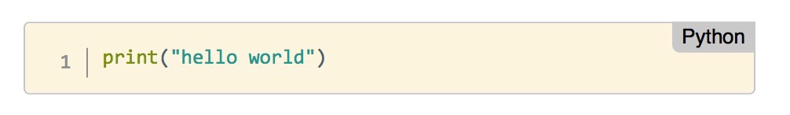
Python programming
Let’s see what a Python program looks like.
We’ll start with the classic "Hello World!" program:
This code will print the message "Hello World!" on the screen.
Notes:
1 MINUTES
TALKING POINTS
Note that this program can run on it’s own or be used as part of a larger program.
TEACHING TIPS

Slide 42
What did we just see?
Data
“hello world”
string
Denoted by quotation marks
Single ‘...‘
Double “...”
Triple “””...”””
Function
Print
Aside: # makes comments
Notes:
1 MINUTES
TALKING POINTS
See the demo file
TEACHING TIPS

Slide 43
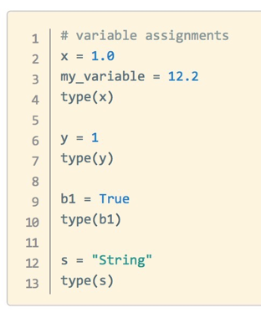
Variables
Types
Bool - 1 or 0, True or False
Int - number w/o decimal point
Float - number w/ decimal
String - text
Assignment
= operator defines variable
Variable names
snake_case
Lowercase Letters, Numbers, Underscores
type() function - shows data type
Notes:
3 MINUTES
TALKING POINTS
Focus on the bolded items
Do an example in jupyter notebook
Only run through 1 example on the right, leave the rest to the reader
TEACHING TIPS
Lots on this slide, keep it superficial… just providing a sneak peek at python

Slide 44
Variables
Operators - combine data
+, -, *, / (add, subtract, multiply, divide)
+=, -=, etc ( perform operation and save result)
** (power)
//, % (quotient, remainder (modulus))
>, <, ==, !=, <=, >= (greater than, less than, equal, not equal, etc)
Functions and methods - saved instructions to manipulate data
abs(my_int) - function_name(data)
len(my_string)
my_string.lower() - data.method_name()
my_int.__add__(5)
“Dunder” - double underscore (__) = important Python built in item
Notes:
4 MINUTES
TALKING POINTS
See the demo notebook for live code example (very simplistic)
Focus on
defining the operations
Emphasize methods start with “data dot” method name
TEACHING TIPS

Slide 45
Practice in Jupyter notebook
5 minutes
Now you try! Pair up with a partner to attempt the following in your notebooks. Help each other out!:
Create variables
Bool
Int
Float
String
Check their class with type()
Try out some operations on your variables
What works? What causes errors?
Notes:
5 MINUTES
TALKING POINTS
This exercise is to make sure everyone can open JNB and execute a cell
It is okay if students don’t finish all the items
TEACHING TIPS

Slide 46
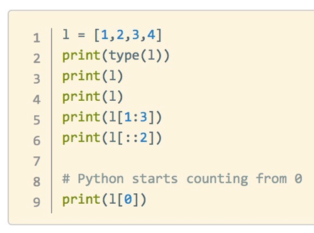
Data Structures
Lists
A collection of objects
Mixed types are okay
Defined with square brackets [ ]
They can be modified
my_list.append()
my_list.remove()
Slicing
Access elements
my_list[ start : end : step ]
Notes:
3 MINUTES
TALKING POINTS
See the demo notebook for live code
There are methods for modifying lists
Slicing!!!
TEACHING TIPS

Slide 47
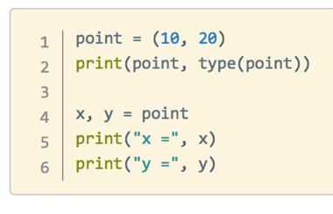
Data Structures
Tuples
very similar to lists, but:
They are defined with parentheses ( ) instead of square brackets
They cannot be changed
No append() method
No remove() method
Slicing works the same way
Notes:
1 MINUTES
TALKING POINTS
Focus on the bolded items, no demo here
TEACHING TIPS
Goal is to show Python is not a fad, and based on strong fundamentals

Slide 48
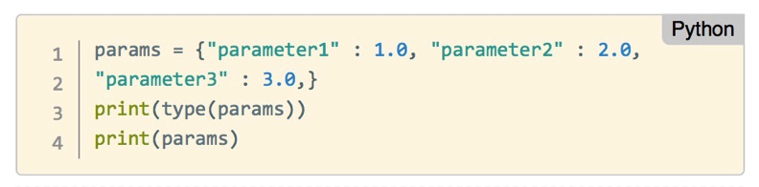
Data Structures
Dictionaries
Collections of key/value pairs
Defined by curly brackets { }
Slicing uses keys
Order is not preserved
Notes:
2 MINUTES
TALKING POINTS
Focus on the bolded items
TEACHING TIPS
Goal is to show Python is not a fad, and based on strong fundamentals

Slide 49
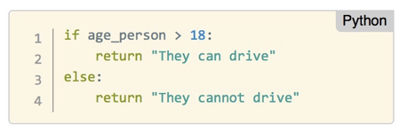
Control Structures
If / elif / else
Check conditions with boolean operators (i.e. <, >, ==)
Execute a single code block depending on result
If True: code runs
Can be:
if alone
f/else
if/elif(s)/else
Indentation controls end of if block
Data controls which code runs
Notes:
4 MINUTES
TALKING POINTS
Focus on the bolded items
TEACHING TIPS
Goal is to show Python is not a fad, and based on strong fundamentals

Slide 50
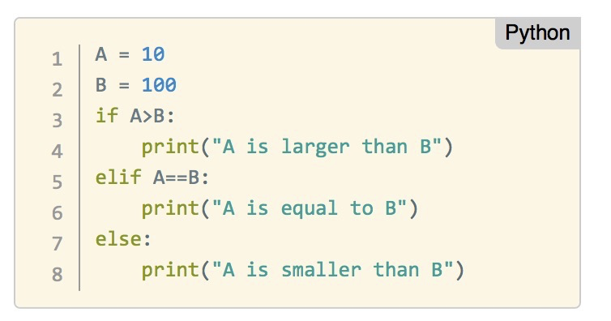
Control Structures - if
Notes:
1 MINUTES
TALKING POINTS
Focus on the bolded items
TEACHING TIPS
Goal is to show Python is not a fad, and based on strong fundamentals

Slide 51
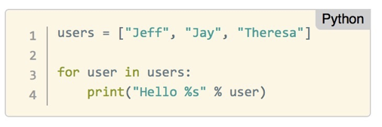
Control Structures
for loop
Repeat operations
Loop variable takes each value from list in turn
Indentation controls end of loop
Watch out for infinite loops!
Interrupt or restart kernel when this happens
Notes:
2 MINUTES
TALKING POINTS
Focus on the bolded items
TEACHING TIPS
Goal is to show Python is not a fad, and based on strong fundamentals

Slide 52
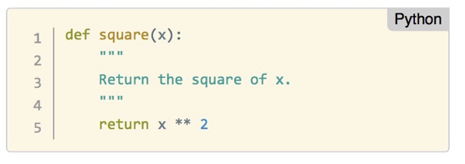
Control Structures
Functions
Groups of instructions repeat / create abstractions of common tasks.
Divide our code into useful blocks
Provide order, making the code more readable and reusable
def name(input1, input2, …) :
First line is “Document String” describing how function works
Definition saves instructions only - no execution!
Notes:
2 MINUTES
TALKING POINTS
Focus on the bolded items
TEACHING TIPS
Goal is to show Python is not a fad, and based on strong fundamentals

Slide 53
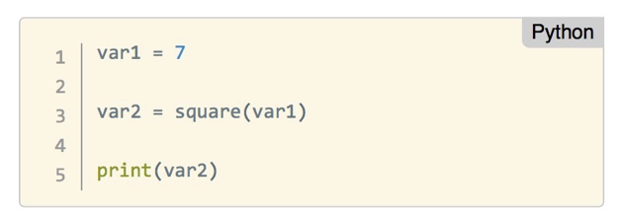
Control Structures
Functions
Run functions with parentheses after the name
Needs to be defined before it can be executed!
The return value is saved in var2
Other functions can be run on the result!
Notes:
1 MINUTES
TALKING POINTS
Focus on the bolded items
TEACHING TIPS
Goal is to show Python is not a fad, and based on strong fundamentals

Slide 54

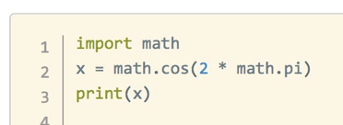
Expanding python
Packages
Install new libraries to add functionality to Python:
conda install <name>
or
pip install <name>
Use packages by importing them into your Python scripts
Notes:
2 MINUTES
TALKING POINTS
Focus on the bolded items
TEACHING TIPS
Goal is to show Python is not a fad, and based on strong fundamentals

Slide 55
Expanding python
Common Packages
Data manipulation: pandas, Numpy, scipy
Machine Learning: scikit-learn, nltk
Databases: psycopq2, sqlalchemy
Visualizations: matplotlib, plotly, bokeh
API calls / web scraping: requests, BeautifulSoup, Scrapy
Web development: Django, Flask, Twisted, Scapy
Game Development: Pygame, Pyglet
Desktop App: pyQt, Tkinter
More
Notes:
2 MINUTES
TALKING POINTS
Call out items the class expressed interest in
TEACHING TIPS
Goal is to show Python is not a fad, and based on strong fundamentals

Slide 56
I have students learn Python in our undergraduate and graduate Web courses. Why? Because there's nothing else with the flexibility or as many pre-built libraries...
Prof. James A. Hendler, Univ. of Maryland
Notes:
1hr 25 MINUTES up to this point
TALKING POINTS
NOTE TO STUDENTS: explain the similarities between packages and libraries

Slide 57
Python Programming Practice!
Intro to Python

Slide 58
Master: Instruction Notes
Timing check: 1h25min
Notes:
1hr25 MINUTES
TALKING POINTS

Slide 59
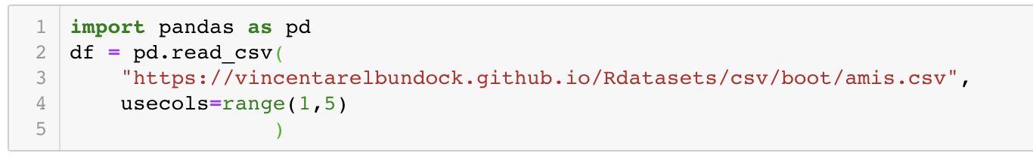
Data Analysis Datafile
2
Start a new notebook and rename it to speeding_example
Import pandas and load the dataset
Google R datasets, should see listing as second hit linking to https://vincentarelbundock.github.io/Rdatasets/datasets.html
We are using the amis dataset, fifth on that page
Notes:
2 MINUTES
TALKING POINTS
This is a suggested talking point.
This is another.
TEACHING TIPS
This is a suggestion for the instructor on something to do before, during or after presenting this slide.
This is another suggestion.

Slide 60
Data Analysis Overview
5
The data used here show measured car speeds with 3 other labels:
pair - There are 14 pairs of data collected
warning - For each pair, two sections of road were measured:
Where a warning sign was placed for part of the experiment
Whether there was a similar stretch of road in another part of town where no sign was erected during the experiment (control)
period -There are 3 time periods in the data for each pair:
Before the warning sign was placed on road section 1
Just after the sign was placed on road section 1
Some time after the sign was erected (so the sign is no longer "new")
Notes:
5 MINUTES
TALKING POINTS
Pair: 14 pairs of data collected
Warning: two sections of road measured per pair
Period: 3 time periods of data for each pair; each period has about 100 points

Slide 61
Data Analysis
5
We want to study how the average speed changes in one section of road after the sign was erected, so we need to:
√Read the data
Loop over the rows of data
Select data only from the group of interest (just pair 7)
Compute the answer
Notes:
10 MINUTES
TALKING POINTS
Go through the notes in the slide deck here
TEACHING TIPS
This is a suggestion for the instructor on something to do before, during or after presenting this slide.
This is another suggestion.

Slide 62
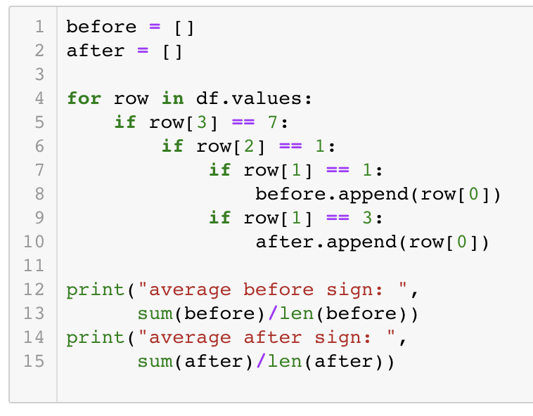
Data Analysis Recap
3
Create lists to store data of interest
For loop over all the data
Nested if statements to filter just the:
Pair
Warning
Period
we are look for
Save data to appropriate list
Print average of list after loop
Notes:
3 MINUTES
TALKING POINTS
This is a suggested talking point.
This is another.
TEACHING TIPS
This is a suggestion for the instructor on something to do before, during or after presenting this slide.
This is another suggestion.

Slide 63
Data Analysis Script
5
Change the Notebook name to speeding_example
Note no spaces!
File > Download As > Python (.py)
Click Keep if Browser warns file may be dangerous
Open new Terminal (or Anaconda Prompt) window
Change to Downloads folder in Terminal
type: cd Downloads and press enter
Run the python script
Type: python speeding_example.py and press enter
Note only the printed output lines appear in the terminal!
Notes:
5 MINUTES
TALKING POINTS
Go through the notes in the slide deck here
TEACHING TIPS
This is a suggestion for the instructor on something to do before, during or after presenting this slide.
This is another suggestion.

Slide 64
The goal is to turn data into information, and information into insight.
Carly Fiorina, Former CEO, Hewlett-Packard
Notes:
1hr 45min up to this point
TALKING POINTS
This is a suggested talking point.
This is another.
TEACHING TIPS
This is a suggestion for the instructor on something to do before, during or after presenting this slide.
This is another suggestion.

Slide 65
Let’s Review
Intro to Python
Notes:
TALKING POINTS:
Let’s spend a few minutes talking about any outstanding questions that you have.

Slide 66
Master: Instruction Notes
Timing check: 1hr45min
Notes:
X MINUTES
TALKING POINTS
This is a suggested talking point.
This is another.
TEACHING TIPS
This is a suggestion for the instructor on something to do before, during or after presenting this slide.
This is another suggestion.

Slide 67
Review and Recap
In this workshop, we've covered the following topics:
Python as a popular, flexible programming language
Python has applications in many different areas
Python is particularly great for data manipulation
Python programming basics include: types, variables, functions, and more!
Notes:
2 MINUTES
TALKING POINTS
Focus on the bolded items
TEACHING TIPS
Goal is to show Python is not a fad, and based on strong fundamentals

Slide 68

Finish That Sentence
“Something that really got me thinking is...”
“The best thing I got out of this unit is…”
What are your biggest takeaways from this lesson?
“I discovered…”
“I still want to learn about…”
“I was surprised to learn that…”
Notes:
TALKING POINTS:
On your own, spend a few moments to think about this unit. What did you take away? What would you like to learn more about? How can you use this new information?
Complete one of the following sentences (then ask them to share):
My favorite thing we learned about today was…
The best thing I got out of today is…
After this week, I plan to…
I’m excited to learn more about…
TEACHING TIPS:
Instructors should ask if anyone wants to share out loud.
Give participants a few minutes, then have them share out (either at tables or to the whole class, based on time).

Slide 69

Ask Me Anything!
Notes:
Purpose: Wrap up and answer outstanding questions
Let’s spend a few minutes talking about any outstanding questions that you have.

Slide 70

We appreciate your feedback!
Please take 60 seconds to complete our survey.
Notes:
KEEP OR DELETE THIS SLIDE DEPENDING DEPENDING ON DIGITAL OR PAPER SURVEY! Connect with your C&W producer on whether you run paper or digital surveys for Intro Classes!
PLEASE DROP THE LINK FROM YOUR PRODUCER IN THIS SLIDE IF YOU ARE DOING A DIGITAL SURVEY
Here are some best practices:
Regardless if Ask everyone to complete the survey prior to Q&A or final thoughts. Reasoning is that if you do Q&A/final thoughts, people check out mentally, or worse, leave. Having everyone to complete the survey prior to those items has worked really well. So moving that survey slide with the shortlink before Q&A or final thoughts is key.
Ask everyone to share their feedback and take 2-3 minutes to allow everyone to do so. Previous instructors have said something like, "This is a free class. The only thing we ask in return is your feedback so we can improve this workshop. Let's take 2-3 minutes to do that."
For digital survey only: Works on mobile too: Although the slide suggests it, it's good to verbally say that it works on mobile too.

Slide 71
Next Steps
Intro to Python
Notes:
TALKING POINTS:
Let’s spend a few minutes talking about any outstanding questions that you have.

Slide 72
Create a learning plan
What’s next?
Solidify your learning:
Go through the parts of Learn How to Think Like a Computer Scientist.
Familiarize yourself with the language by going through A Beginner's Python Tutorial.
Practice Practice Practice! Problems to expand your skills are available at:
HackerRank
CodeWars
Notes:
2 MINUTES
TALKING POINTS
I also like Intro to Statistical Learning for people looking to go more of the data route
TEACHING TIPS
Goal is to show Python is not a fad, and based on strong fundamentals

Slide 73
Create a learning plan
General Assembly also offers courses that teach you how to use Python!
Check out our:
Part-time Data Science Course
Data Science Immersive Course
Online Part-time Data Science Course
Part-time Python Course
Online Part-time Python Course
Notes:
2 MINUTES
TALKING POINTS
Focus on the bolded items
TEACHING TIPS
Goal is to show Python is not a fad, and based on strong fundamentals

Slide 74

A Few Good References
Official Python Documentation
PEP-8 Official Guide
Anaconda Tutorials
Jupyter Documentation
Example Notebooks
Notes:
TEACHING TIPS:
MySQL functions and operators: https://dev.mysql.com/doc/refman/8.0/en/functions.html

Slide 75
THANK YOU!
See you next time!

